Slide 1
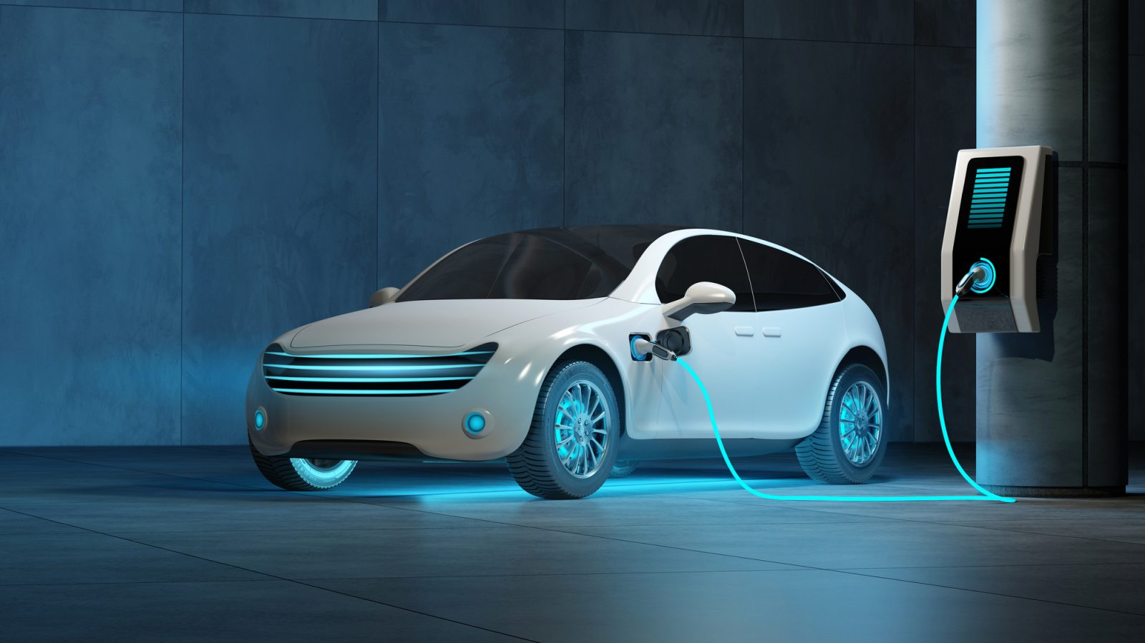
Promotion of Electric Vehicles in Hong Kong
Prediction of the situation
with ARIMA model
By Team Harmony Leung Pui Shan (16) Lee Chung Kei (17) Chan Siu Keung (3) Chan Koon Kit (12)

Slide 2
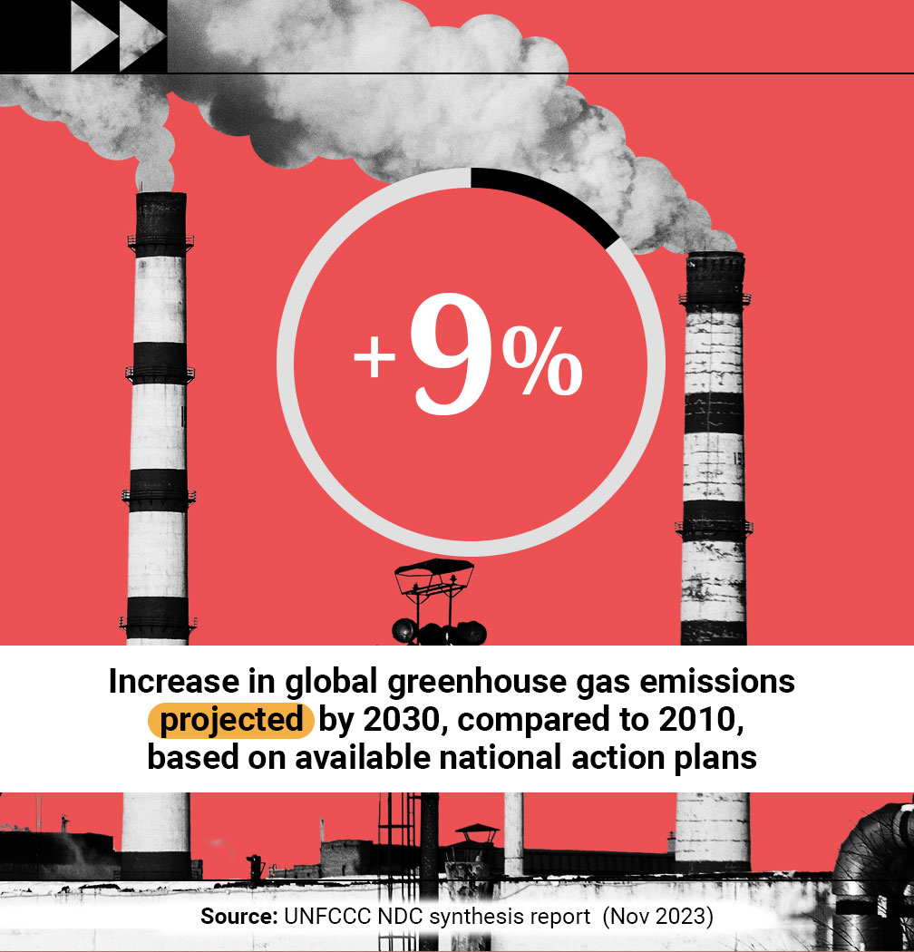
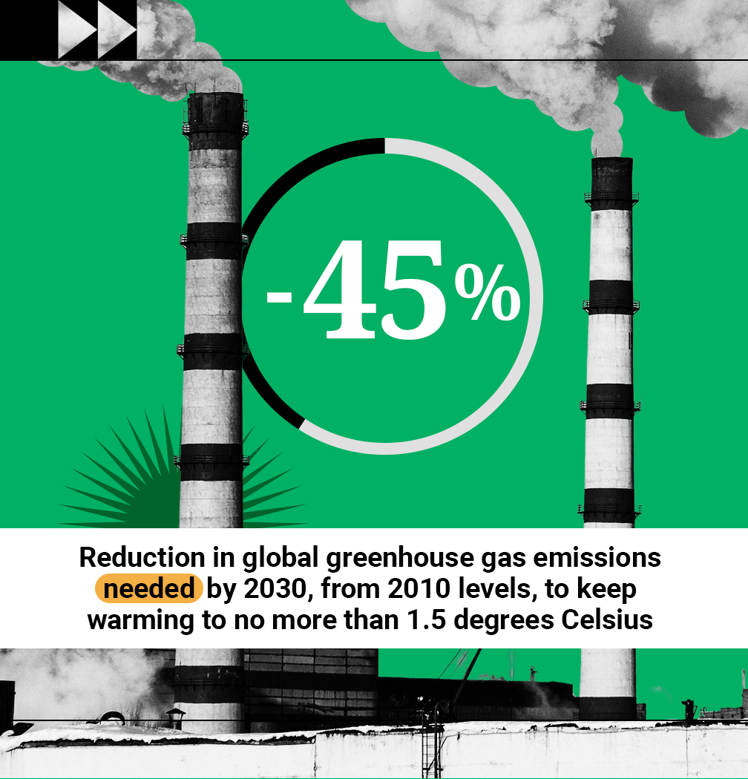
Introduction
-United Nations:
-Race to Zero
taking immediate action to halve global emissions by 2030
Reference: https://www.un.org/en/climatechange/net-zero-coalition

Slide 3
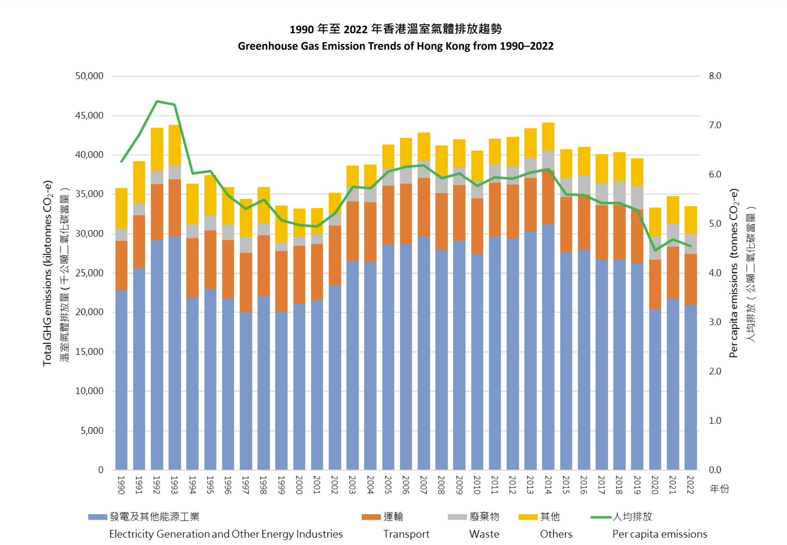
Hong Kong transportation
Transportation sector contribute 19.2% of total carbon emission in 2022
To halve the carbon emission by halve from 2010 to 2030, switching to electric vehicles is a must.
https://cnsd.gov.hk/wp-content/uploads/2023/12/Greenhouse-Gas-Emissions-in-Hong-Kong-by-Sector.pdf
https://cnsd.gov.hk/wp-content/uploads/2023/11/Greenhouse-Gas-Emission-Trends-of-Hong-Kong_v2.2.pdf

Slide 4
Aim of Study:
- Investigate the future situation of promoting Electric Vehicles (EV) in Hong Kong
Analysis of Asian markets (Hong Kong, China, Taiwan, and Japan)
Use ARIMA modeling to find the year of zero-carbon emission programme
Suggest means for government to promote the electric vehicles

Slide 5
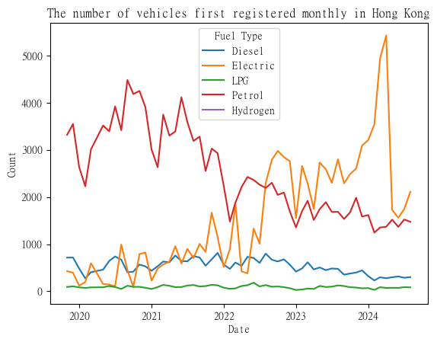
There is a sudden drop in the electric vehicle sales:
Starting from 2024:
First registration fee is 100% waived for public transport cars from $97,500 to $58,500
For 1 exchange for 1 scheme, reduced from $287,500 to $172,500 starting from 2024 April 1st.
For private car with taxable amount more than 500,000, there are no waiving tax.

Slide 6
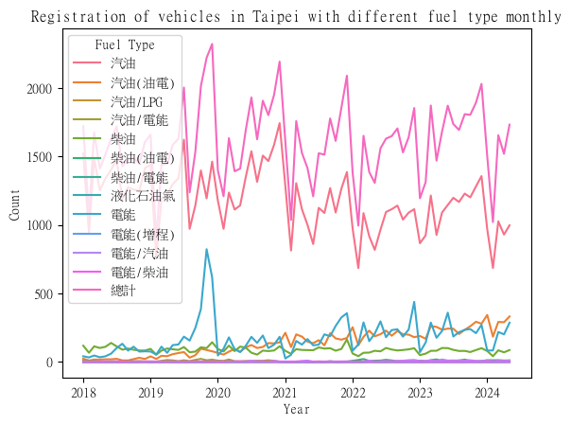
Government Policy 2019 suspended in 2020
Raised and flattened

Slide 7
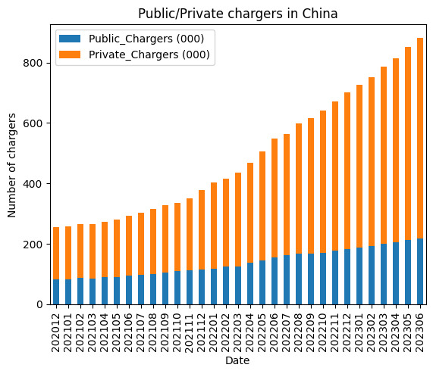
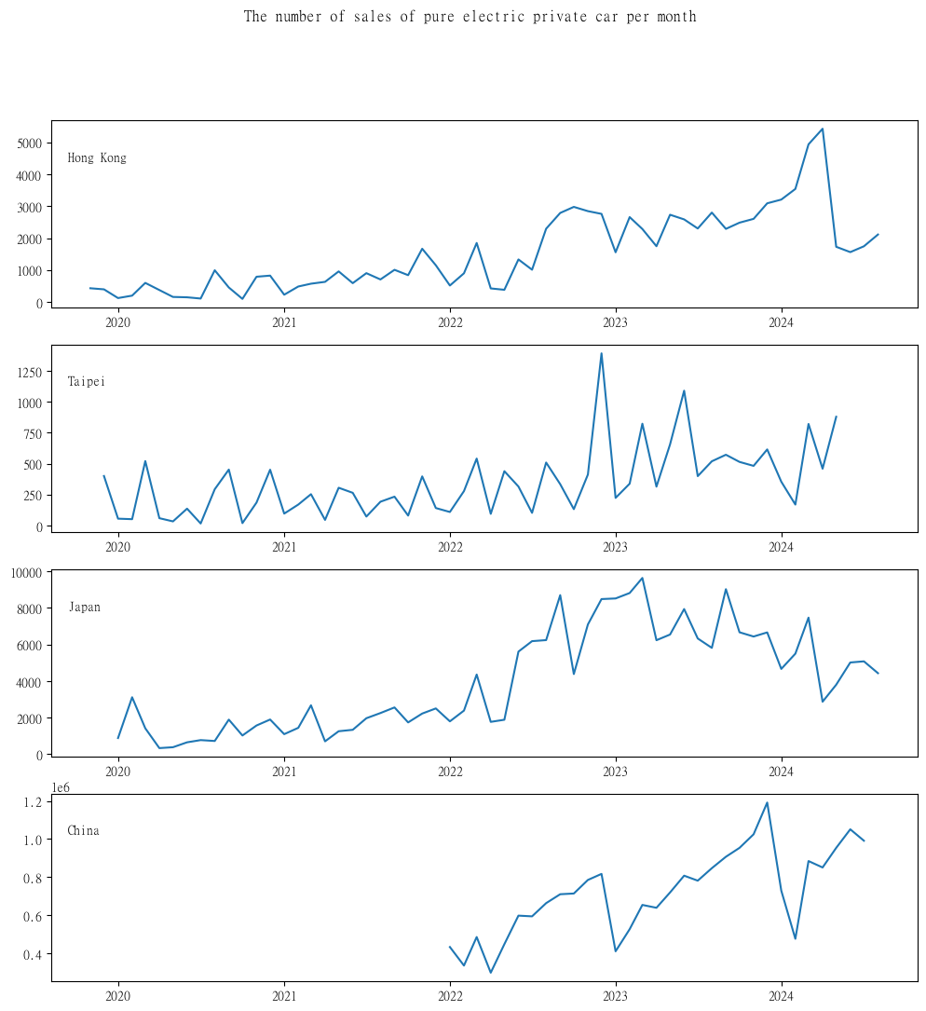
China is the most successful market among the four markets supported by the infrastructure numbers
-China has reached a ratio of electric vehicles to
charging station 2.51:1 in December of 2022.
-The ratio of EV and EV charging station suggested by EU is 10:1.
-Hong Kong and Taipei are both 9:1. Japan is 6:1

Slide 8
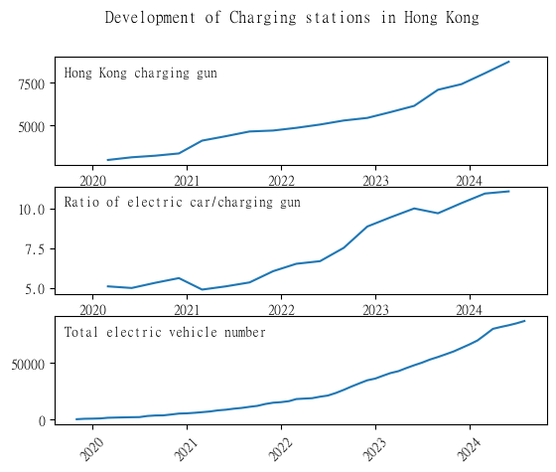
The charging gun is obviously not enough!
The increasing trend of charging gun and electric vehicle is simultaneously.
The ratio of electric car/charging gun is increasing in Hong Kong. (from 5.0 to over 10)
The ratio is even greater than Euro Standard
Suggest: Government to keep building more charging station is a must!

Slide 9
Modeling
Using of ARIMA (AutoRegressive Integrated Moving Average)
time series fitting to mimic the periodic trend
forecast the trend of sales of electric vehicles
X-axis: Monthly time-series( 2024 Jan, 2024 Feb, 2024 March)
Y-axis: Sales of Electric vehicles in Hong Kong and Petrol vehicles in Hong Kong
Parameters:
p: The lag order, representing the number of lag observations incorporated in the model.
d: Degree of differencing, denoting the number of times raw observations undergo differencing.
q: Order of moving average, indicating the size of the moving average window.
p = 4: There are 4 significant factors which will impact the sales
d = 1 : it is not stationary
q = 1 : any periodic trends

Slide 10
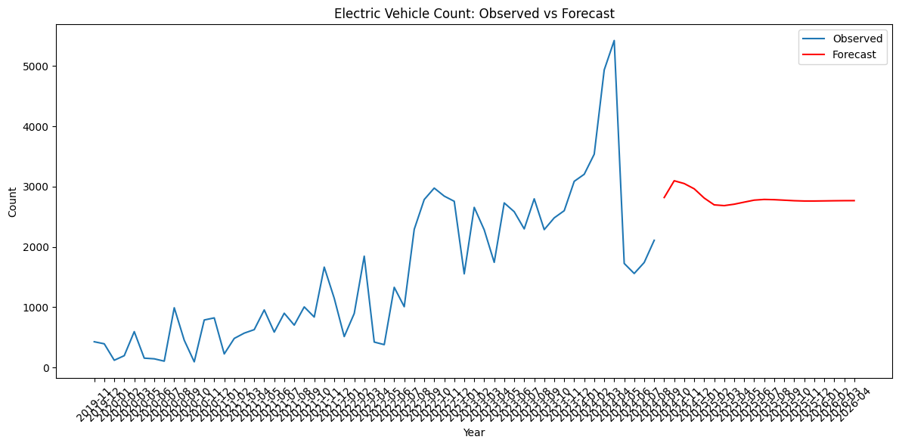
HK Like Taipei: Flattened due to policy suspension

Slide 11
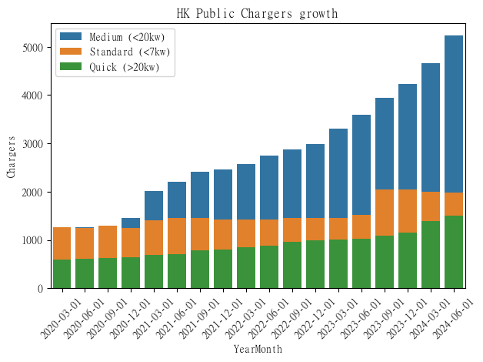
Mainly built charging station in these year is medium charging station(blue), fast charging station (orange) is not enough!
In 2019, Hong Kong announced a $2 billion pilot subsidy scheme, The application period has been ended in 2023 December 31 as the upper limit $3.5 billion dollar upper limit is reached.

Slide 12
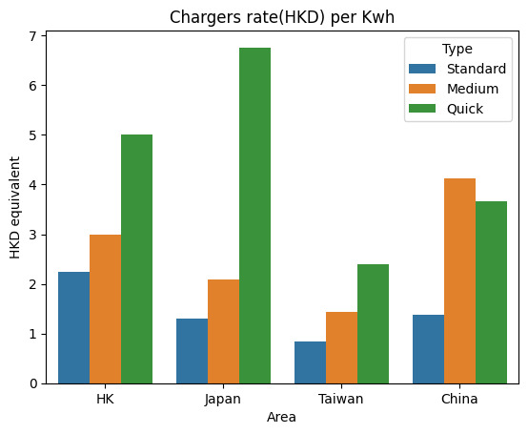
Recommendation to Government:
Shrink the approval requirement of the pilot scheme:
Only subsidize building quick charger parking station
subsidized car parks need to
Align with government charging station: $3HKD
Upgrade standard and medium charger to quick
For Northbound Travel for Hong Kong Vehicles
Provide a wider choice of charger type

Slide 13
Recommendation to HK government:
1. Enhanced Incentives:
- Increase tax rebates or provide direct subsidies for EV purchases.
- Offer discounts on public transport or parking benefits for EV owners.
2. Charging Infrastructure:
- Invest in expanding the charging network, ensuring convenient access across urban and rural areas.
- Implement fast-charging stations to reduce charging time.
3. Public Awareness Campaigns:
- Initiate campaigns to educate the public on the benefits of EVs, including cost savings, environmental impact, and government support.
- Showcase successful EV users in the community to encourage adoption.

Slide 14
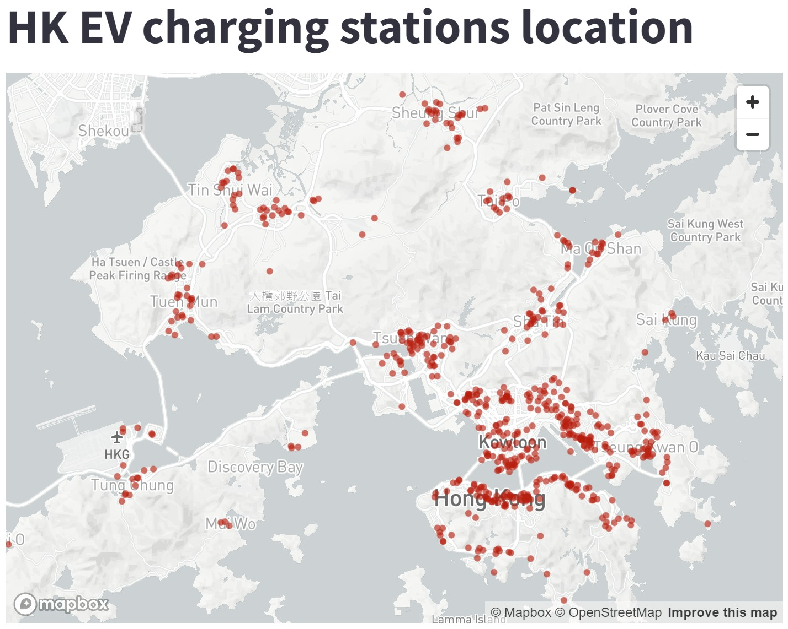
Average distance between charging station =12.88km Many of stations are located in urban area. Taipei average distance is 5.19 km Recommend: build more charging station in country side

Slide 15
Conclusion
Meeting the zero-carbon policy by 2035 in Hong Kong will require a multifaceted approach that combines forecasting EV trends with concerted efforts in policy, infrastructure, and public engagement. By employing strategic initiatives, the shift from fuel vehicles to electric vehicles can accelerate, aligning with environmental goals.

Slide 16

Thank you

